Slide 1

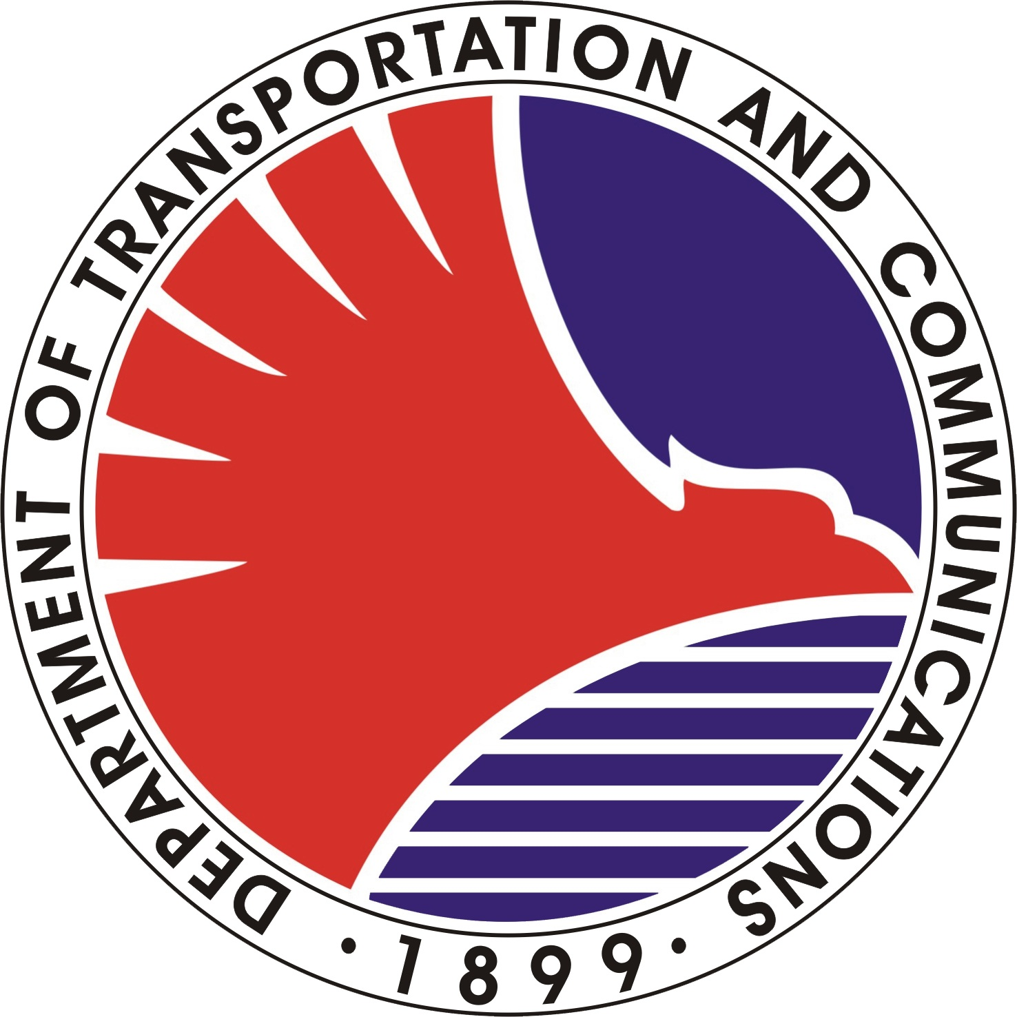
REPUBLIC OF THE PHILIPPINES
Department of Transportation and Communications Metro Rail Transit 3 (DOTC - MRT3)
This certificate is issued to
for having completed the training for Ticket Seller II conducted by the Support Staff/Computer Section/AFC Center on August 01 - 31, 2012 Given this 5th day of August 2013 at the North Triangle Area, Quezon City
ROGELYN GURADILLO

